Slide 3
【本週英語作業】
1.聆聽和跟讀英語 CD。
2.完成英語習作P50~P51。

Slide 4
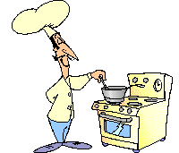
a cook

Slide 5
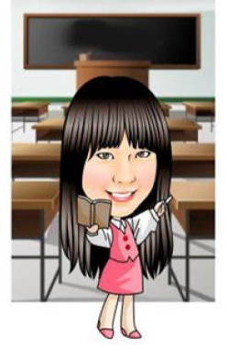
a teacher

Slide 6
a student

Slide 7
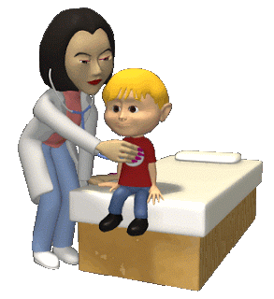
a doctor

Slide 8
a nurse

Slide 9
a teacher
a cook
1
2
3
a student
5
a nurse
4
a doctor

Slide 10
a teacher
a cook
1
2
3
a student
5
Boom!
4
a nurse
6
a doctor

Slide 11
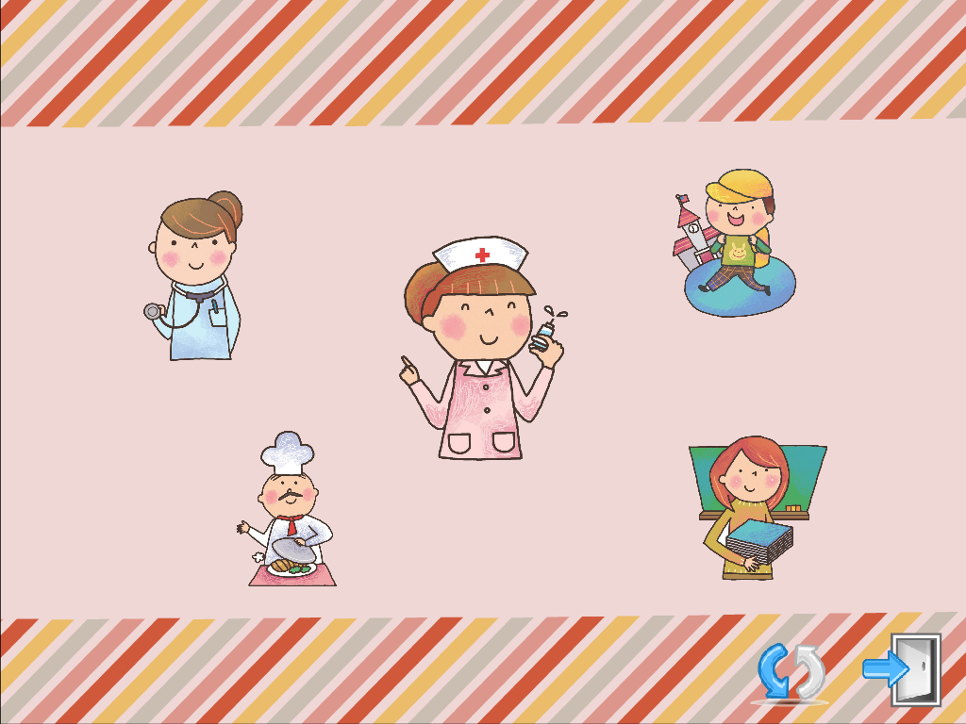

Slide 12
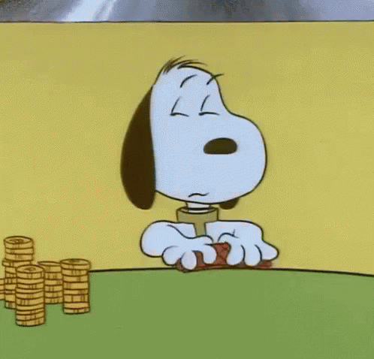
Let’s play the card games!
Role call
(Who is a _____?
I’m a ______.)
2. Matching

